Slide 1
Handwritten Digit Recognition Using Deep Learning
Submitted in the partial fulfillment for the award of the degree of
BACHELOR OF ENGINEERING
IN
Computer Science with Specialization in Artificial Intelligence and Machine Learning
Submitted by:
Tanisha Nagpal 21BCS5286
Aaditya Singh 21BCS6750
Avi Singh 21BCS6761
Disha Saini 21BCS6773
Ishaan Shandilya 21BCS6777
Under the Supervision of:
Prof. Shaveta Jain
Department of AIT-CSE
DISCOVER . LEARN . EMPOWER

Slide 2
Outline
Introduction to Project
Problem Formulation
Objectives of the work
Methodology used
Results and Outputs
Conclusion
Future Scope
References

Slide 3
Introduction to Project:
Handwritten Digit Recognition Using Deep Learning
Handwritten digit recognition is a fundamental problem in the field of machine learning and artificial intelligence. This project aims to develop a system that can accurately recognize handwritten digits using Convolutional Neural Networks (CNNs) implemented in Python with TensorFlow. The primary objective is to create a robust and efficient model for digit recognition and compare its performance across various configurations of hidden layers.

Slide 4
Handwritten digit recognition is the task of automatically recognizing handwritten digits from images.
It is a challenging task due to the variability in handwriting styles.
Deep learning has been shown to be very effective for handwritten digit recognition.
In this presentation, we will discuss the use of deep learning for handwritten digit recognition.
We will also present a case study of a deep learning model that achieves state-of-the-art accuracy on the MNIST dataset.

Slide 5
Problem Formulation
Input: A grayscale image of a handwritten digit.
Output: The predicted digit, one of the numbers from 0 to 9.
Hypothesis: The model is a deep learning model, such as a convolutional neural network (CNN).
Loss function: The loss function is a measure of the difference between the predicted digit and the ground truth digit. A common loss function for handwritten digit recognition is the cross-entropy loss function.
Optimization algorithm: The optimization algorithm is used to train the model. A common optimization algorithm for handwritten digit recognition is the stochastic gradient descent (SGD) algorithm.
Evaluation metric: The evaluation metric is used to measure the performance of the model. A common evaluation metric for handwritten digit recognition is the accuracy, which is the percentage of images that are correctly classified.

Slide 6
Objectives of the Work
To develop a deep learning model that can accurately recognize handwritten digits from images.

Slide 7
Methodology used
Collect the dataset. The first step is to collect a dataset of images of handwritten digits. The dataset should be large and diverse, so that the model can learn to recognize a wide variety of handwriting styles. The MNIST dataset is a commonly used dataset for handwritten digit recognition. It consists of 60,000 training images and 10,000 test images.
Preprocess the data. The images in the dataset may need to be preprocessed before they can be used to train the model. This may involve steps such as resizing the images, normalizing the pixel values, and removing noise.

Slide 8
Design the model. The next step is to design the deep learning model. The model should have a structure that is able to learn the features of handwritten digits. A common approach is to use a convolutional neural network (CNN).
Train the model. The model is trained by iteratively minimizing the loss function. This is done by feeding the model a batch of images and their labels, and then updating the model's parameters. The training process can be computationally expensive, so it is important to use a powerful computer or a cloud computing platform.
Test the model. Once the model is trained, it is tested on a held-out test set of images. The accuracy on the test set is used to evaluate the performance of the model.
Deploy the model. Once the model is deployed, it can be used to recognize handwritten digits in real-time.

Slide 9
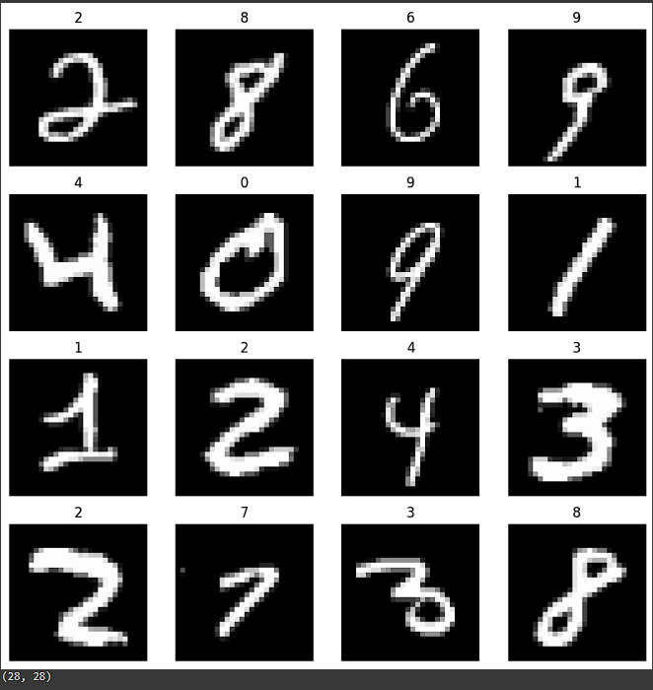
Results and Outputs
MNIST Dataset is loaded into our model and here, 16 random images are shown here after training which demonstrates that the digits are correctly labelled and the dimensions of the images are outputted below, i.e 28x28.

Slide 10
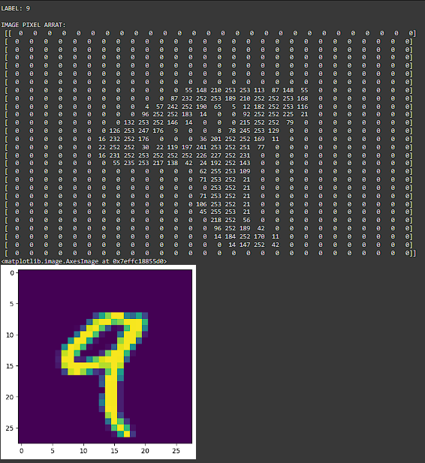
Results and Outputs
For demonstration purposes, the number "9" is chosen, and its Image Pixel Array is displayed to show how our model recognizes and comprehends the input image.

Slide 11
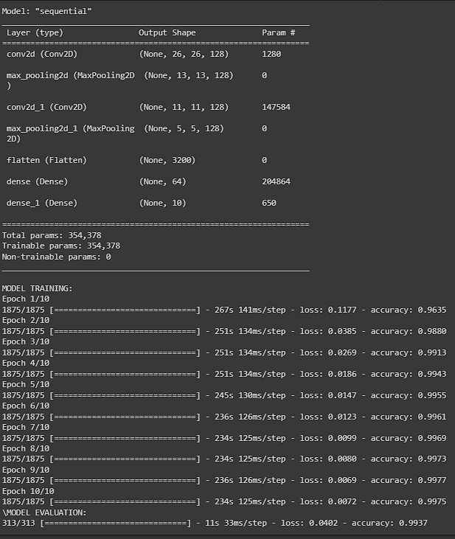
Results and Outputs
During the training process, our model goes through the Convolutional Neural Networks (CNNs) and its output is shown here.
Since there is only little to process, our model reaches upto 99.37% accuracy while training, which is shown here.

Slide 12
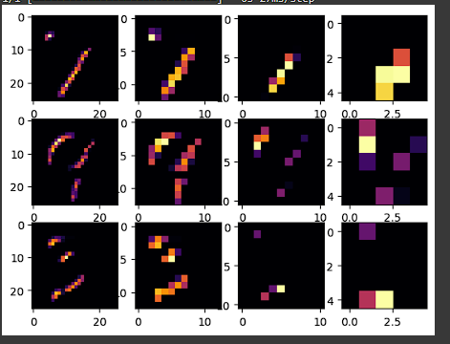
Results and Outputs
Visualisation of how convolutional layers are working.

Slide 13
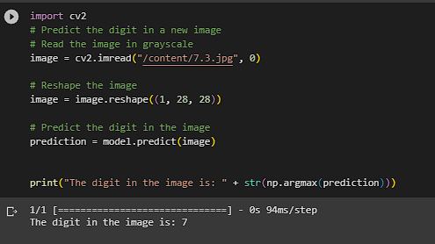
Results and Outputs
Here, the model is tested with unseen data. These were the handwritten digits of our team members
The path “/content/7.3.jpg” signifies that we have inputted the number ‘7’ with its ‘3’ variation of how it could be written and our model detects it correctly, which is shown here

Slide 14
Conclusion
Handwritten digit recognition is the task of automatically recognizing handwritten digits from images. Deep learning has been shown to be very effective for this task. A deep learning model for handwritten digit recognition typically consists of a convolutional neural network (CNN). The CNN is trained on a dataset of images of handwritten digits. The model is then tested on a held-out test set of images. The accuracy of the model is measured on the test set. The model can then be deployed to recognize handwritten digits in real-time.
The challenges of handwritten digit recognition include the variability in handwriting styles and the presence of noise and distortion in the images. Deep learning models can learn the complex patterns in handwritten digits, even when they are noisy or distorted. Deep learning models have achieved state-of-the-art accuracy on the MNIST dataset, which is a commonly used dataset for handwritten digit recognition. Deep learning is still a rapidly evolving field, and there is still room for improvement in the accuracy of handwritten digit recognition models.

Slide 15
Future Scope
The future scope of handwritten digit recognition using deep learning is promising. Deep learning models are still under development, but they have already achieved state-of-the-art accuracy on the MNIST dataset. As deep learning algorithms become more sophisticated, they will be able to recognize handwritten digits more accurately, even in the presence of noise and distortion. In addition, deep learning models can be extended to recognize other types of handwritten characters, such as letters, symbols, and punctuation marks. This would make them more versatile and useful for a wider range of applications.

Slide 16
References
http://yann.lecun.com/exdb/mnist/
https://www.coursera.org/professional-certificates/tensorflow-in-practice?
https://yann.lecun.com/exdb/publis/pdf/lecun-89e.pdf
https://www.youtube.com/watch?v=vStJoetOxJg&list=PLkDaE6sCZn6FNC6YRfRQc_FbeQrF8BwGI&ab_channel=DeepLearningAI

